Slide 1
Advanced Plan Explorer Usage for Tuning Execution Plans
Andy Yun, Principal Solutions Engineer, SentryOne Moderated By: Sajjad Ahmed
Notes:
[Sajjad Ahmed’s Part]
Hi and welcome everyone to this PASS Marathon: SQL Server Performance edition!
Thank you for joining us today for Andy Yun’s session, Advanced Plan Explorer Usage for Tuning Execution Plans.
This PASS Marathon features 7 back-to-back live webinars, delivered by expert speakers from the PASS community.
The sessions will be recorded and over the next few days, you will receive an email letting you know once the recordings become available.
My name is Sajjad Ahmed [you can say a bit about yourself here if you’d like] …
…. and I have a few introductory slides before I hand over the reins to Andy.
[move to next slide]

Slide 2
Notes:
[Sajjad Ahmed’s Part]
For technical assistance, please type your request into the question pane and someone will assist you.
This is also where you may ask any questions during the presentation. Feel free to enter your questions at any time and once we get to the Q&A portion of the session, I will read your questions aloud to Andy.
Finally, note that there will be a short evaluation at the end of the session. This will pop-up in your web browser automatically after this session ends. Your feedback is really important to us for future events, so please take a moment to complete this.
[Note to Sajjad Ahmed : You need to determine which questions are the most relevant and ask them out loud to the presenter].

Slide 3
PASSsummit.com
Notes:
[Sajjad Ahmed’s Part]
This year PASS will be hosting it’s first ever PASS Virtual Summit on November 10-13! Head over to PASS Summit.Com to register and learn more about this year’s lineup.
[move to next slide]

Slide 4




Andy Yun
SQL Server DBA & DB Developer
Chicago Suburban User Group Chapter Leader
Chicago SQL Association – Director-at-Large
Working with SQL Server since 2001
Principal Solutions Engineer, SentryOne
Speaking since Early 2014
https://blogs.sentryone.com/andyyun/
Microsoft MVP (2017-2018)
https://github.com/SQLBek
@ SQLBek
SQLBek@gmail.com / ayun@sentryone.com
Notes:
[Sajjad Ahmed’s Part]
This PASS Marathon session is presented by Andy Yun.
[move to next slide]
This PASS Marathon session is presented by Andy Yun. Andy is a SentryOne Principal Solutions Engineer and a former Microsoft MVP. He has been working with SQL Server for over 15 years as both a Database Developer and Administrator. Leveraging knowledge of SQL Server Internals and extensive experience in highly transactional environments, he strives to make T-SQL leaner and meaner. Andy is extremely passionate about passing knowledge onto others, regularly speaking at User Groups, SQL Saturdays, and PASS Summit.
[move to next slide]

Slide 5
Advanced Plan Explorer Usage for Tuning Execution Plans
Andy Yun, Principal Solutions Engineer, SentryOne Moderated By: Sajjad Ahmed
Notes:
[Sajjad Ahmed’s Part]
And without further ado, here is Andy with Advanced Plan Explorer Usage for Tuning Execution Plans.
Andy begins!
******Andy takes over] ******

Slide 6

Before We Begin…
Notes:
NEXT – Why Clean House?

Slide 7

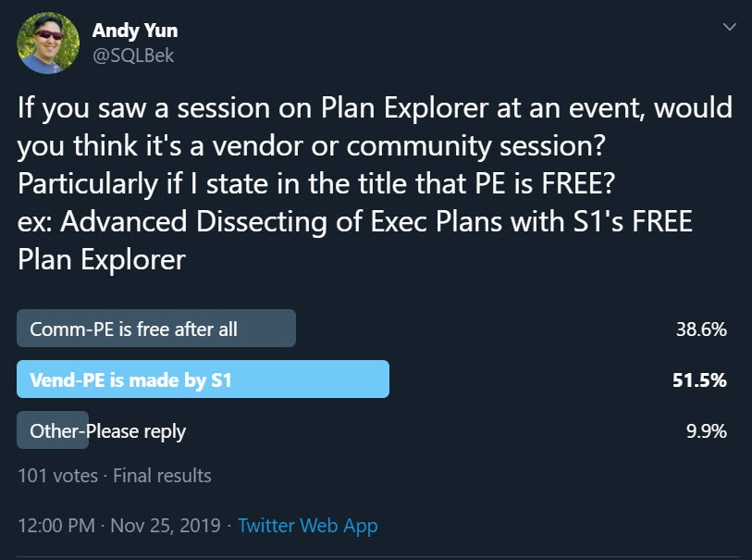
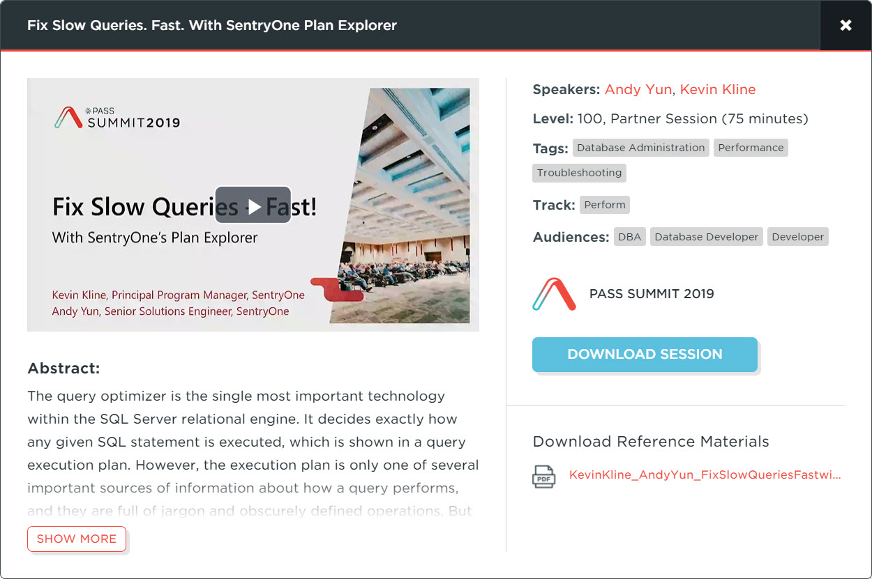
Why Am I Doing This?
Notes:
NEXT – Why Clean House?

Slide 8
Today’s Goal
To showcase advanced features and functionality often overlooked
Mostly demo
Basics will NOT be covered
Increase your speed and productivity
Notes:
NEXT – Why Clean House?

Slide 9
Resources
Plan Explorer Documentation Website https://docs.sentryone.com/help/plan-explorer
Plan Explorer Blog Posts (SentryOne) https://www.sentryone.com/blog/tag/plan-explorer
SQLPerformance.com Blog Posts https://sqlperformance.com/?s=plan+explorer
Plan Explorer Demo Kit by Aaron Bertrand https://www.sentryone.com/blog/aaronbertrand/plan-explorer-3-0-demo-kit
eBook: Query Optimization with SentryOne Plan Explorer by Paul White | Greg Gonzalez | Aaron Bertrand | Rob Farley https://info.sentryone.com/ebook-query-optimization-plan-explorer
Pluralsight: Using SentryOne Plan Explorer by Jonathan Kehayias https://www.pluralsight.com/courses/sqlserver-using-sentryone-plan-explorer
github.com/sqlbek/
Notes:
NEXT – Why Clean House?

Slide 10
SSMS vs Plan Explorer
“I think there are two steps in the
evolution of a query:
(1) ensuring correct results, and
(2) performance optimization”
- Aaron Bertrand
Notes:
NEXT – Why Clean House?

Slide 11
Customizing Your UI

Slide 12
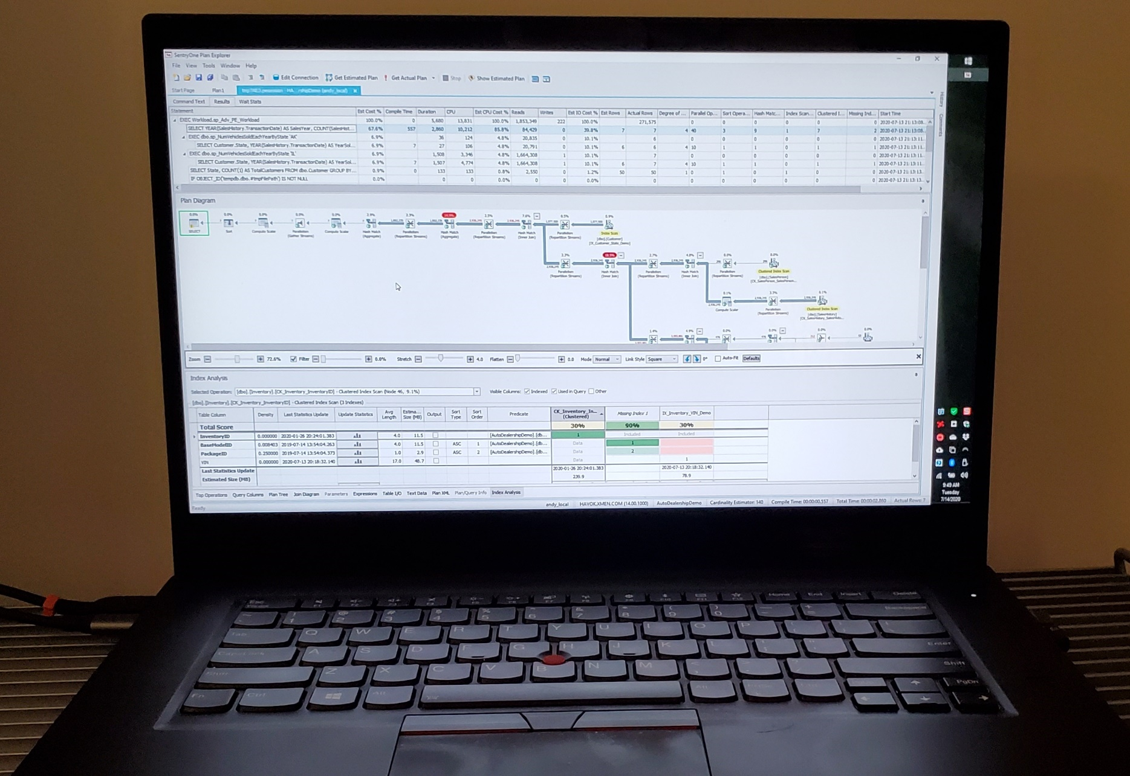

Slide 13
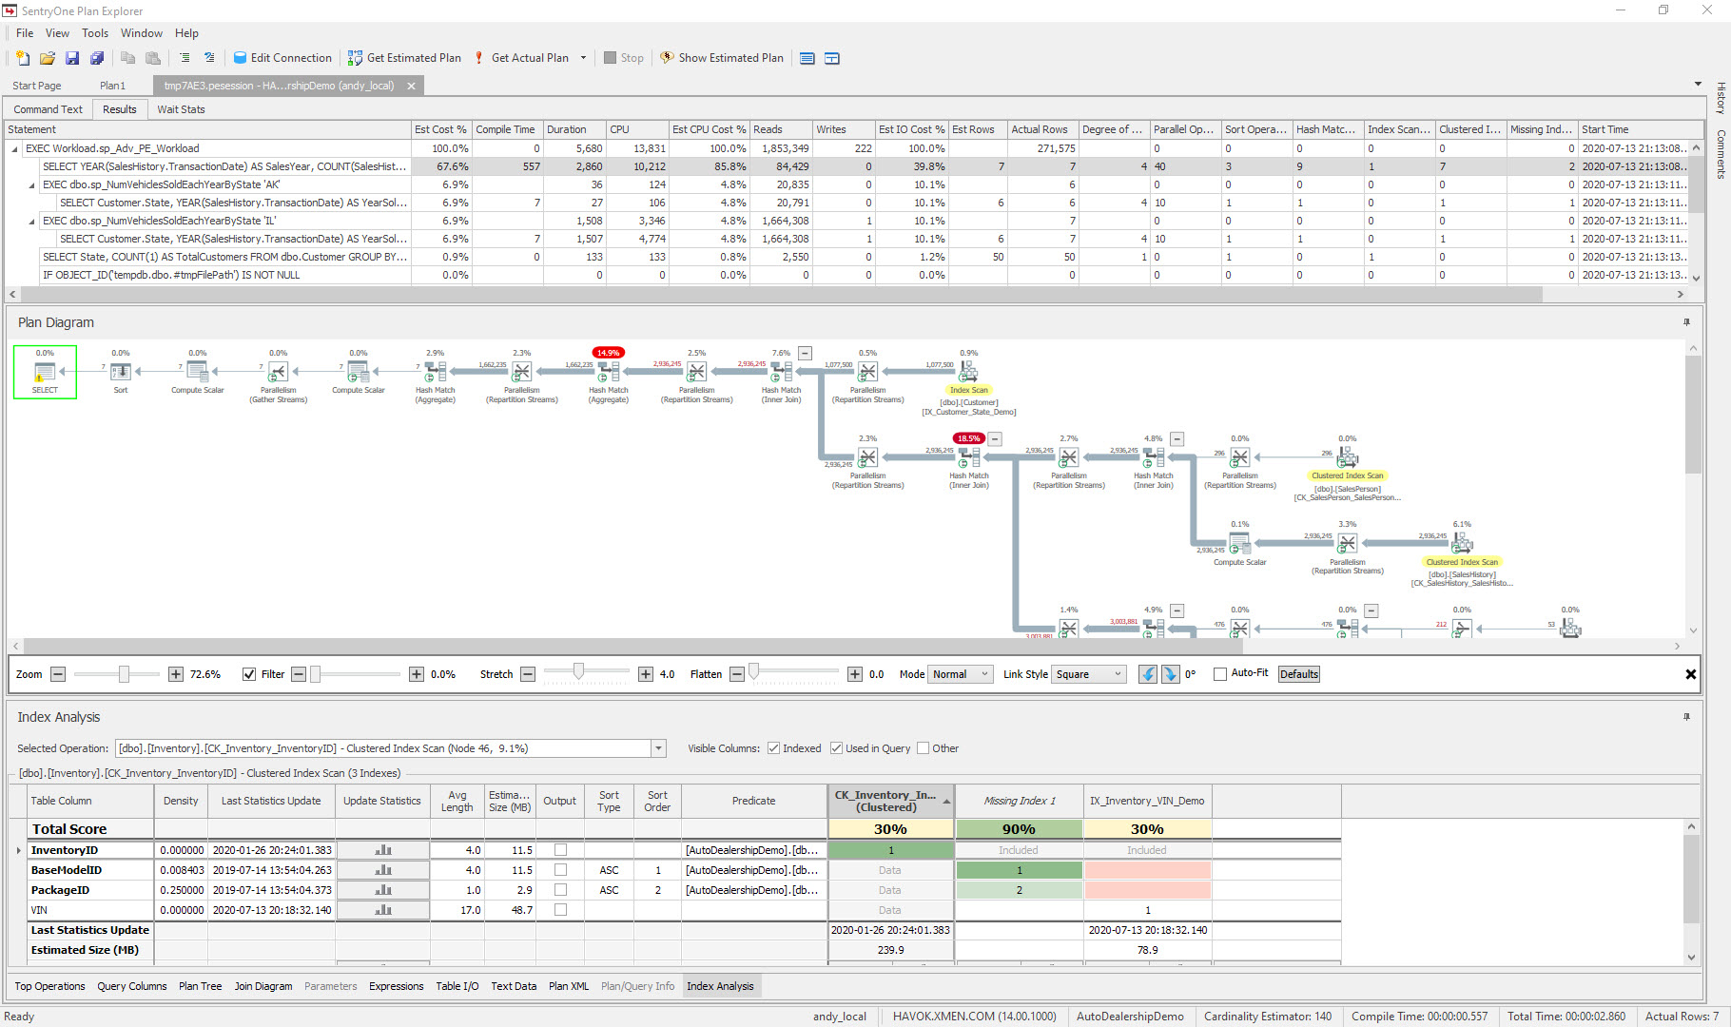
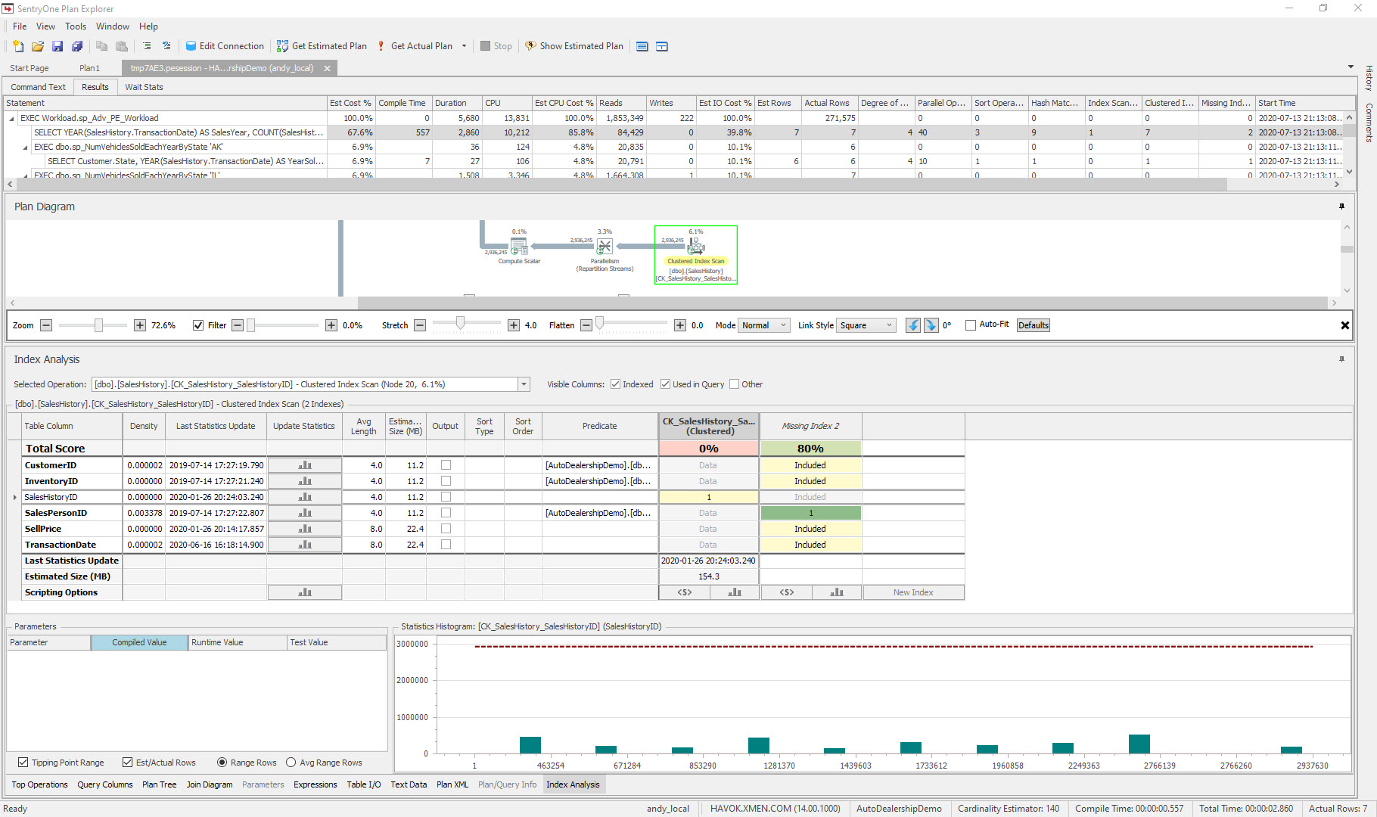

Slide 14
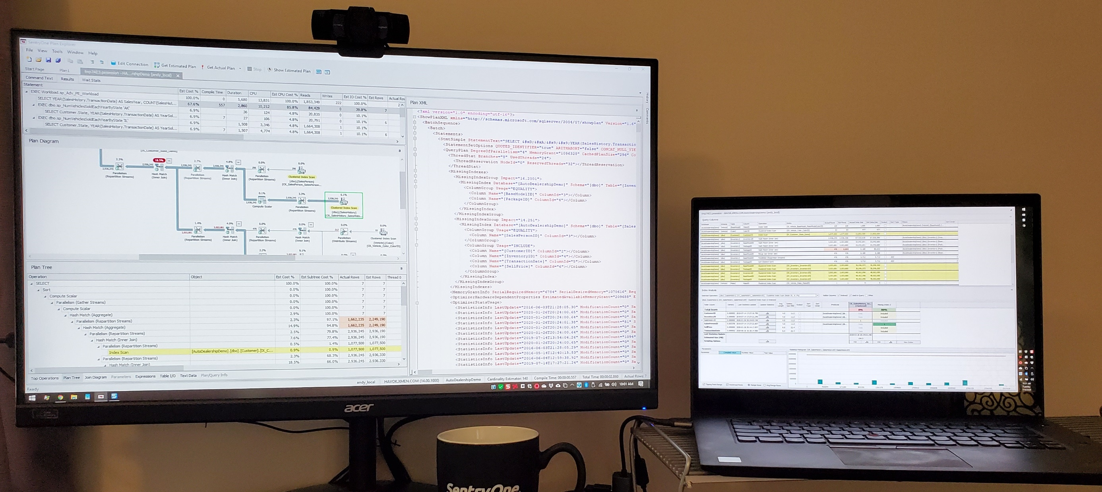

Slide 15
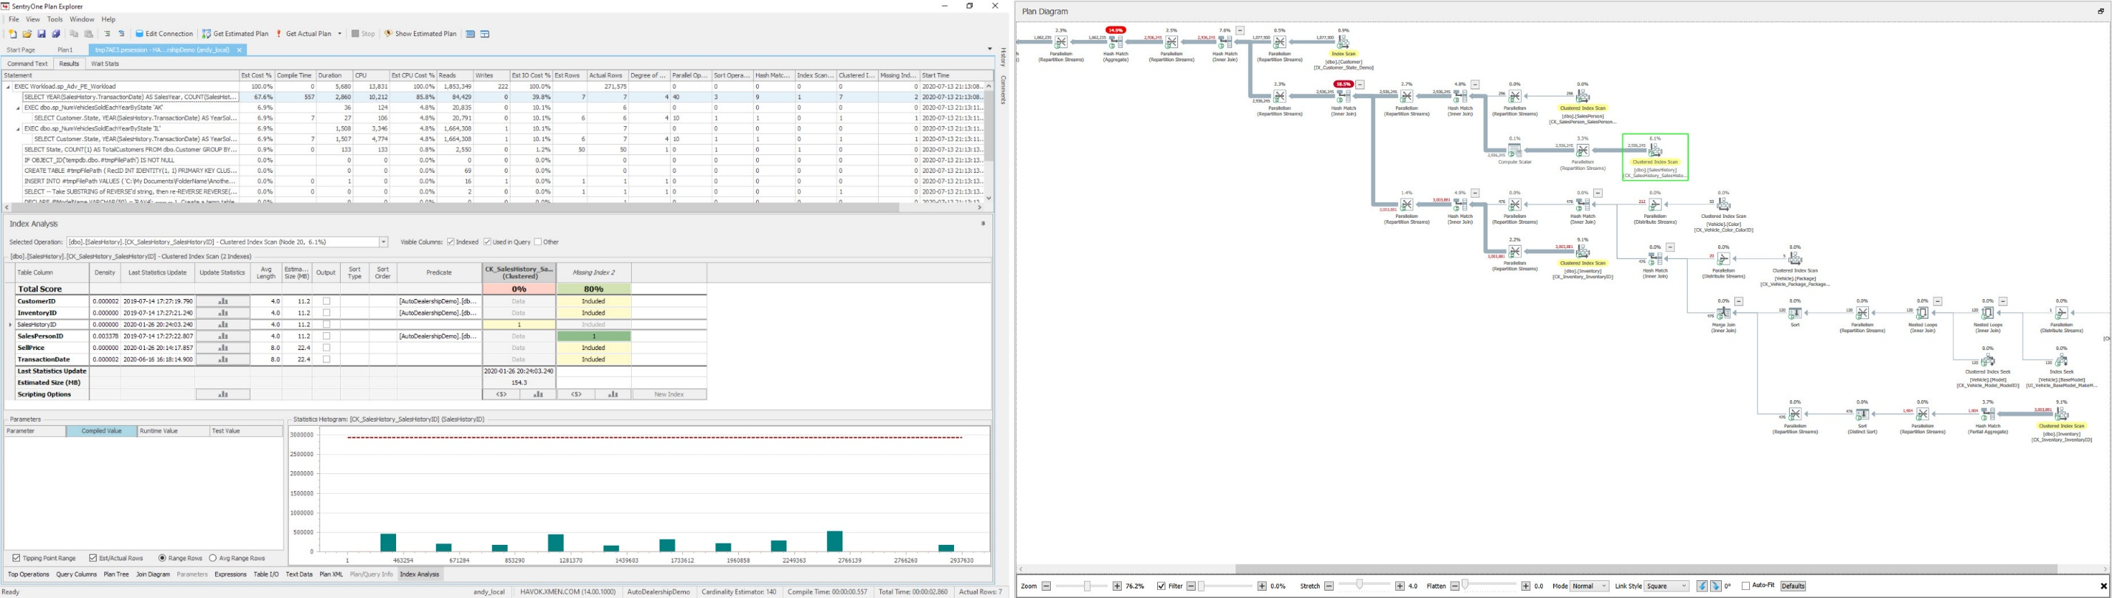

Slide 16
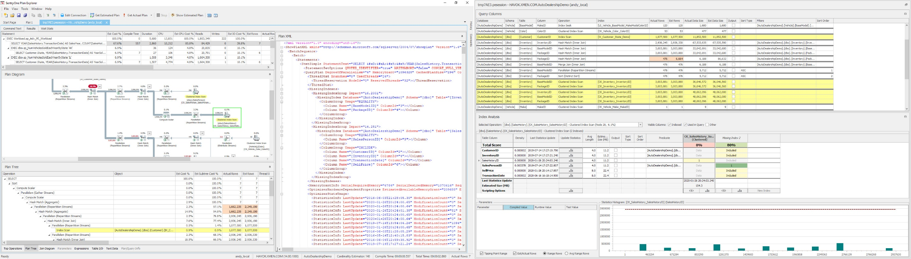

Slide 17
DEMO

Slide 18
Questions?
github.com/sqlbek/
Notes:
Sajjad Ahmed will address questions in order of relevance]
[move to next slide]
Coming up next…

Slide 19
Azure SQL Database Performance Tuning
Jes Schultz
Notes:
Stay tuned for our next session, Azure SQL Database Performance Tuning with Jes Schultz.
[move to next slide]

Slide 20
Learn more from Andy Yun
github.com/sqlbek/
@sqlbek
ayun@sentryone.com
Notes:
[Moderator’s Part]
Moderator script will be added in this section after deck submission.

Slide 21

Presenting Sponsor:

